Slide 1
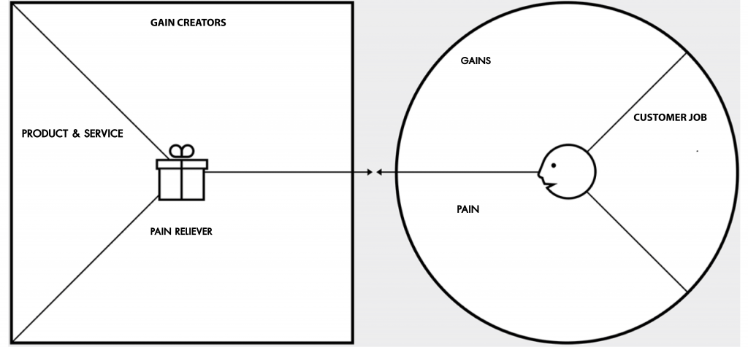
HOMEWORK 03 – Value Proposition Canvas
Watcharaphan Watcharanggurpipat
ID : 6220422111
BADS7105 – CRM Analytics and Intelligence
Have a team for monitoring performance to achieve the goals
Minimize time for trial and error
Get highest efficiency within budget allocation
Success in online business and have a high volume of sales
Have a personal assistant for monitoring performance
Cheaper than trial and error by myself
Run an online business for part time job
The company that provides service for integrated online marketing
Do not have enough time due to full time job in weekday
No knowledge in online business, advertisement and digital marketing.
Minimize time it takes for planning, content creating and making online ads.
Have a team to support and recommend about business and marketing knowledge

